Slide 1
DSC530 Project
Alexis Zimmer
8-13-22

Slide 2
Exploratory Analysis
Proposed Question: How has COVID-19 impacted student behavior?
Implications of Research: better understanding of barriers to success when historical understanding of student behavior is now null due to unprecedented historical shift of education
Hypothesis: Student behavior has had a significant negative shift in performance due to COVID-19, as major barriers to education success, such as caregiving responsibilities, access to computers,and mental and physical health implications have increased in response to the pandemic

Slide 3
Dataset Overview
COVID-19 Impact on Student Performance
Generated dataset that mimics real-world Portland, Oregon 3 semesters ahead of the start of the Pandemic and 3 semesters after the start of the Pandemic
8,401 rows

Slide 4
Variables Selected
The full dataset is useful for analysis as it quantifies student performance before and after a marker in time
Potential explanatory variables can help identify and propose relationships of student performance
studentID = integer ID of respondent
Gradelevel = integer ID of grade level
Gender = binary indicator for M/F
Numcomputers = integer number indicating how many computers are at household
Mothereduc/fathereduc = numerical indicator of highest level of education attained of mother or father
Readingscore/writingscore/mathscore = integer of student score pre-pandemic
ReadingscoreSL/writingscoreSL/mathscoreSL = integer of student score post-pandemic
studentID
school
gradelevel
gender
covidpos
householdincome
freelunch
numcomputers
familysize
fathereduc
mothereduc
readingscore
writingscore
mathscore
readingscoreSL
writingscoreSL
mathscoreSL
timeperiod

Slide 5
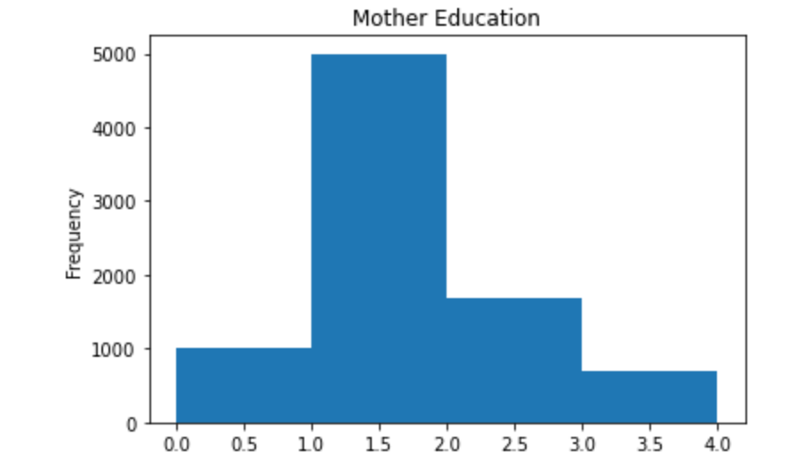
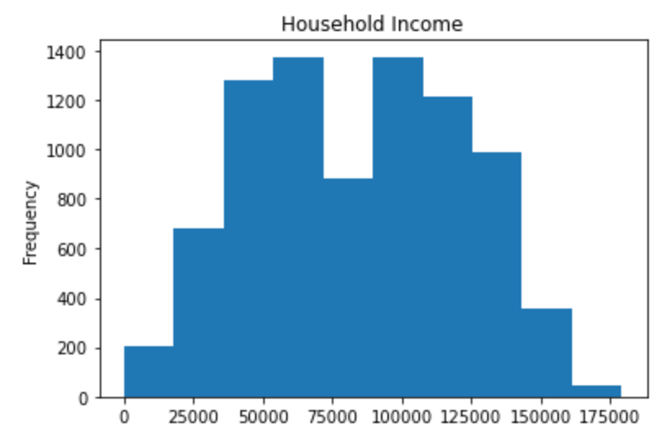
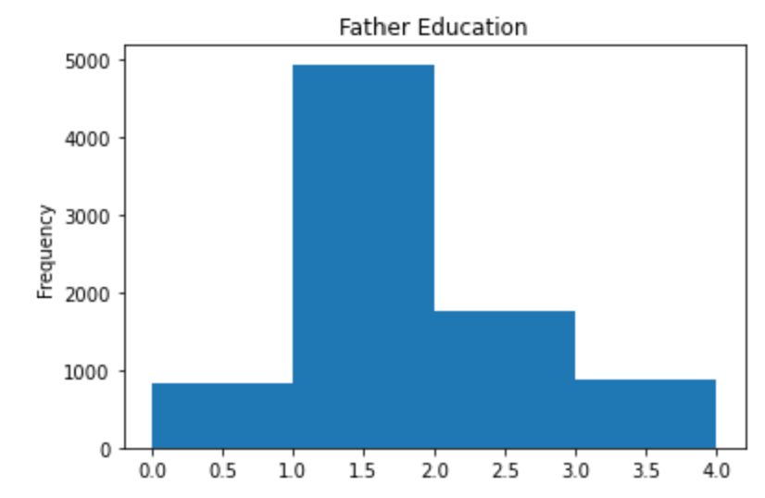
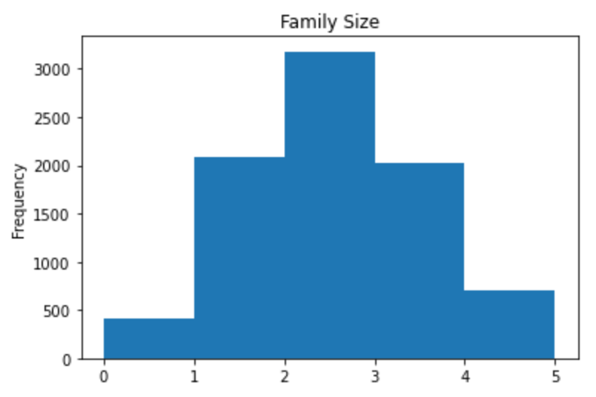
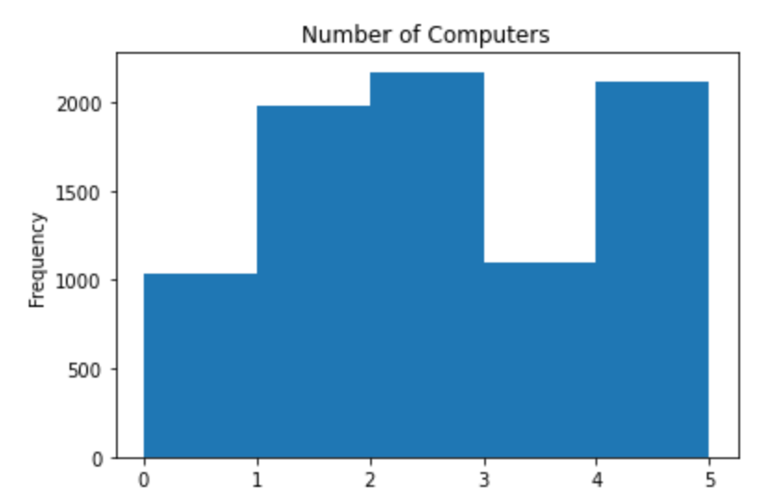
Histograms of 5 Example Variables
Given the small range within the majority of the variables in this dataset, outliers are not identifiable in the examples provided excluding household income. This free-range response indicators a larger spread, but it is difficult to remove any responses given the size of the dataset and non-access to any explanatory reasons for removing any of the min/max values.

Slide 6
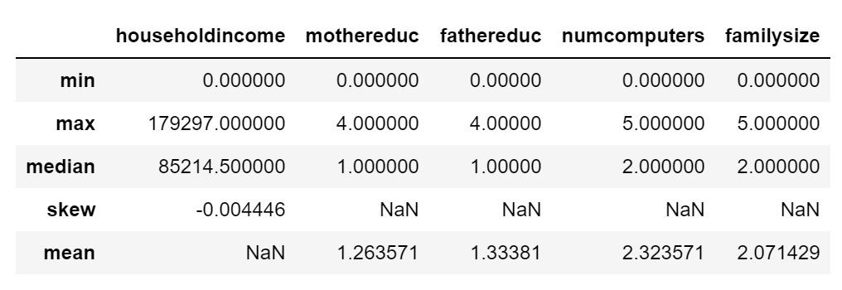
Descriptive Characteristics

Slide 7
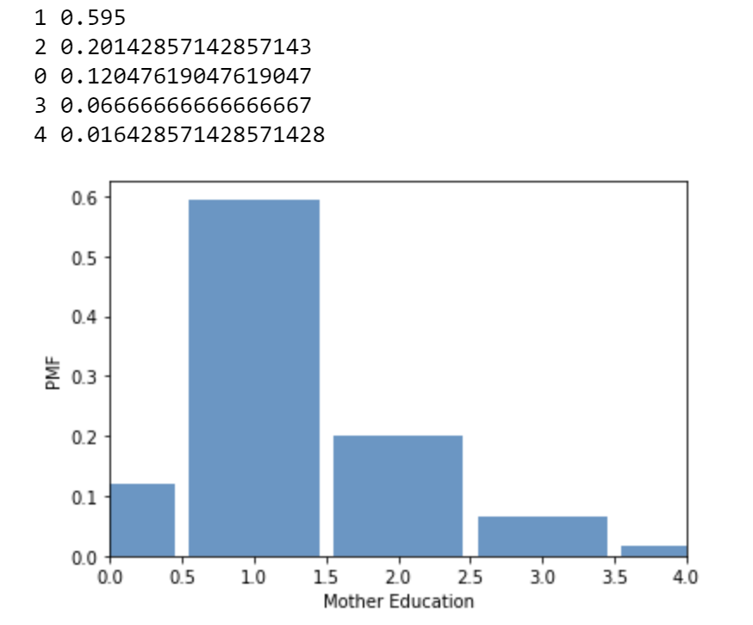
PMF- Scenario 1
Mother education is a possible indicator of student success.
0 = no HS diploma
1 = HS diploma
2 = Bachelor’s Degree
3 = Master’s Degree
4 = Doctoral Degree

Slide 8
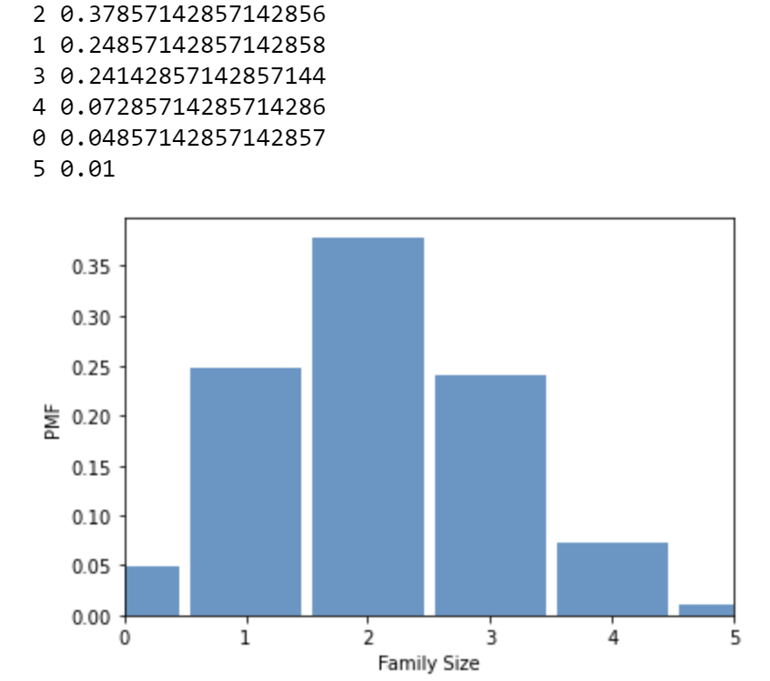
PMF- Scenario 2
Family size helps us better understand the student’s living situation, which may, if provided with further explanatory variables, indicate caregiving responsibilities, access to technology, time spent on studying, etc

Slide 9
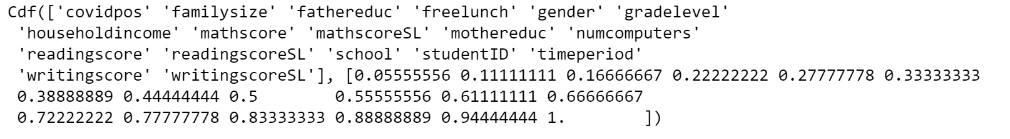
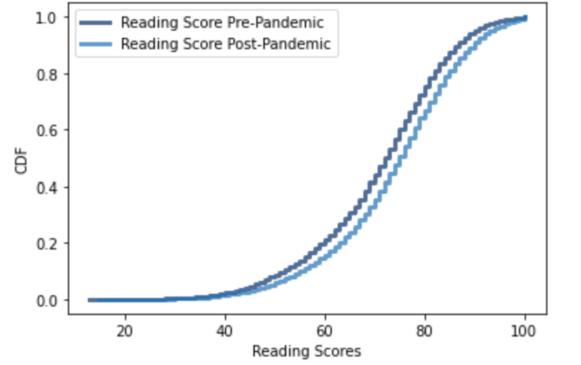
CDF
This confirms that reading scores have shifted downward since the start of the pandemic, which strengthens the argument that student behavior and performance has been negatively impacted due to COVID-19

Slide 10
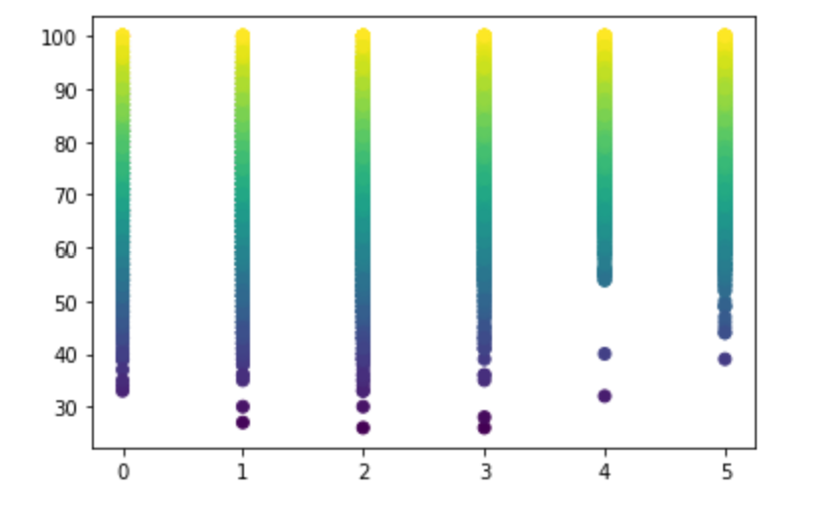

Scatterplot 1
Math scores vs number of computers
Likelihood that access to technology may positively impact a student’s performance

Slide 11
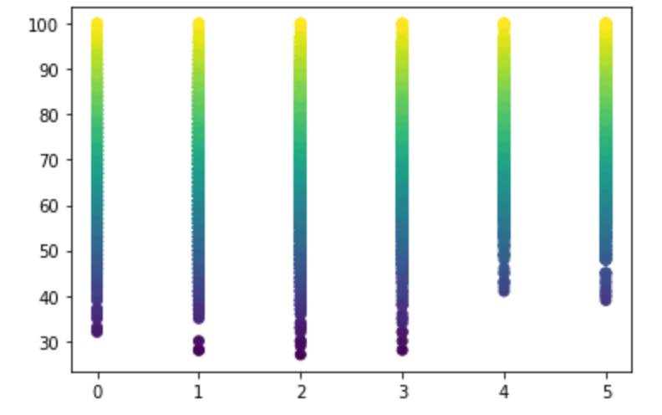

Scatterplot 2
Compares math scores post-pandemic to number of computers in household
Noticeable shift in covariance from pre-pandemic results

Slide 12
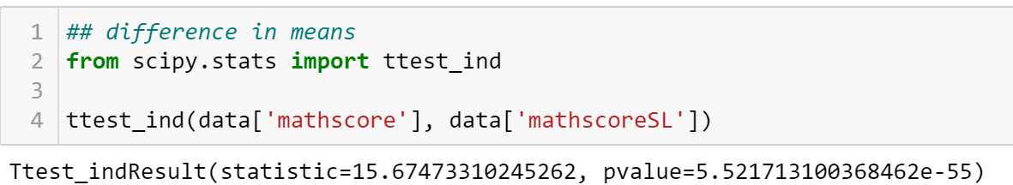
Chapter 9 Test

